Slide 1
Michael Kelly, DeveloperTown
Lessons Learned from
Software Testing at Startups
@esconfs
#esconfs

Slide 2
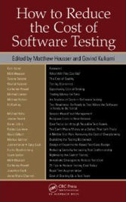
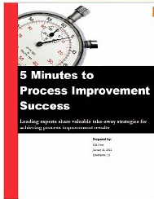
Michael Kelly
Managing Partner, DeveloperTown
www.DeveloperTown.com
Past President, Association for Software Testing
www.AssociationForSoftwareTesting.org
Articles and Blogs
www.MichaelDKelly.com
@esconfs
#esconfs

Slide 3
@esconfs
#esconfs
Notes:
Mechanics…
What is ET?
What’s someone doing?

Slide 4
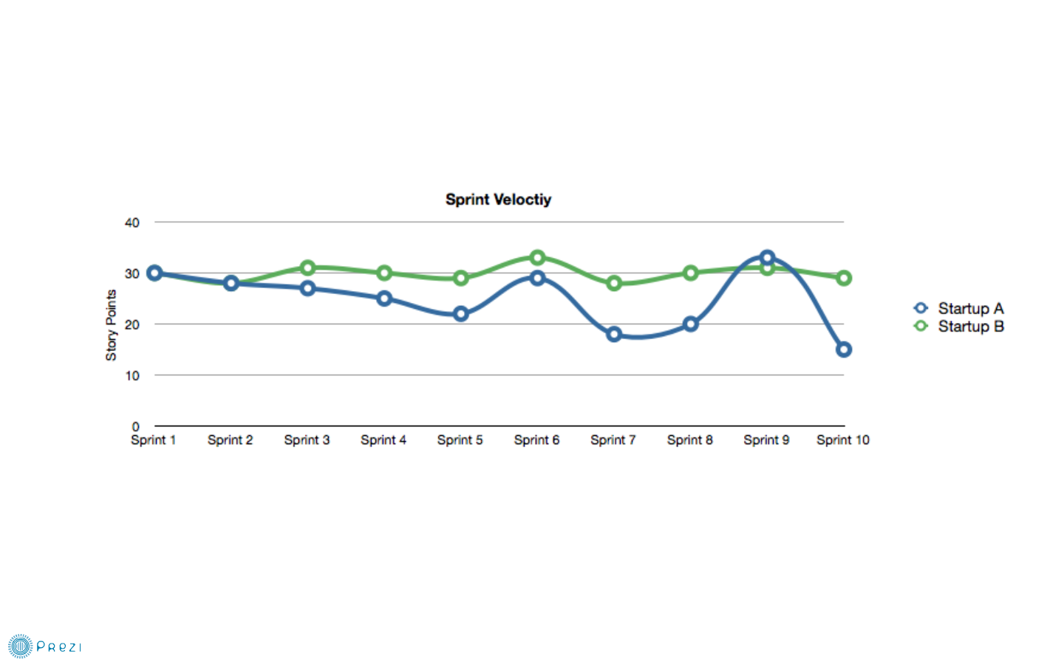
@esconfs
#esconfs
Notes:
Mechanics…
What is ET?
What’s someone doing?

Slide 5
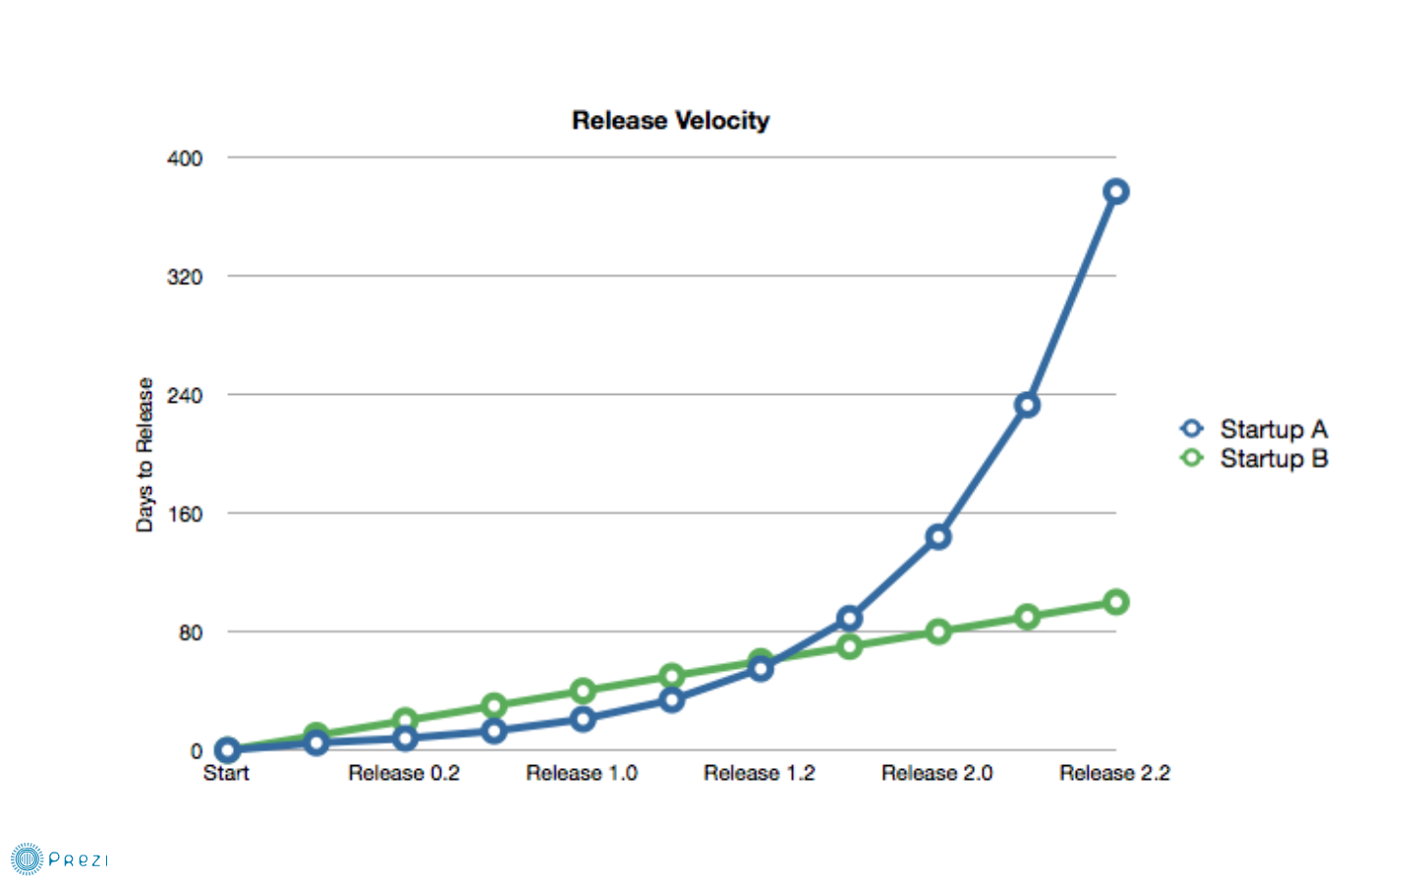
@esconfs
#esconfs
Notes:
Mechanics…
What is ET?
What’s someone doing?

Slide 6
@esconfs
#esconfs
Notes:
Mechanics…
What is ET?
What’s someone doing?

Slide 7
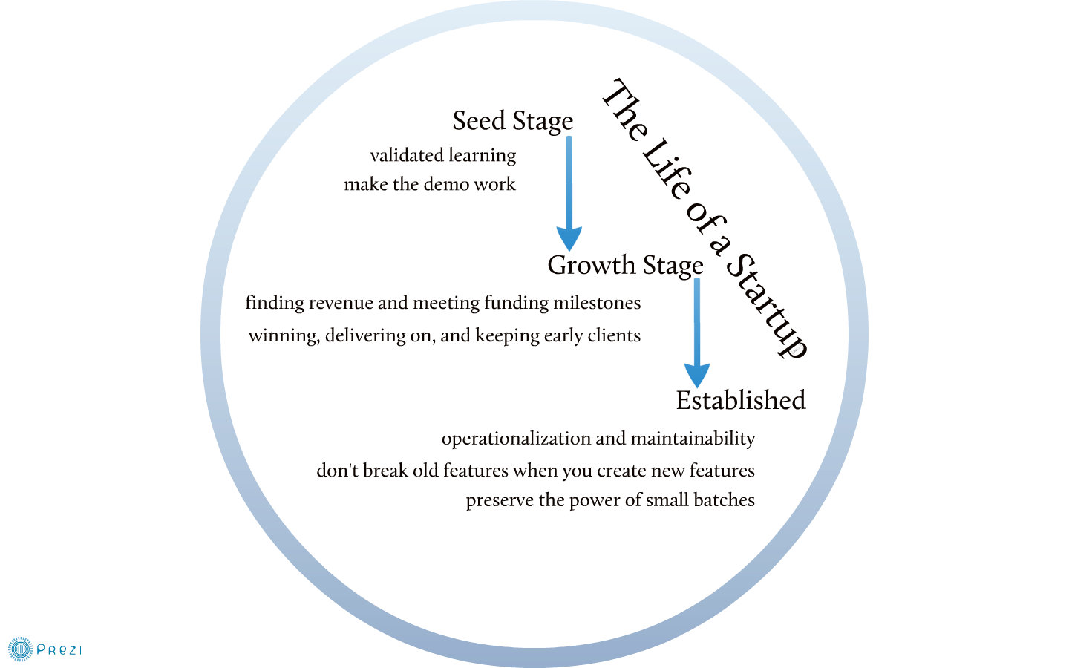
@esconfs
#esconfs
Notes:
Mechanics…
What is ET?
What’s someone doing?

Slide 8
@esconfs
#esconfs
Notes:
Mechanics…
What is ET?
What’s someone doing?

Slide 9
@esconfs
#esconfs
Notes:
Mechanics…
What is ET?
What’s someone doing?

Slide 10
@esconfs
#esconfs
Notes:
Mechanics…
What is ET?
What’s someone doing?

Slide 11
@esconfs
#esconfs
Notes:
Mechanics…
What is ET?
What’s someone doing?

Slide 12
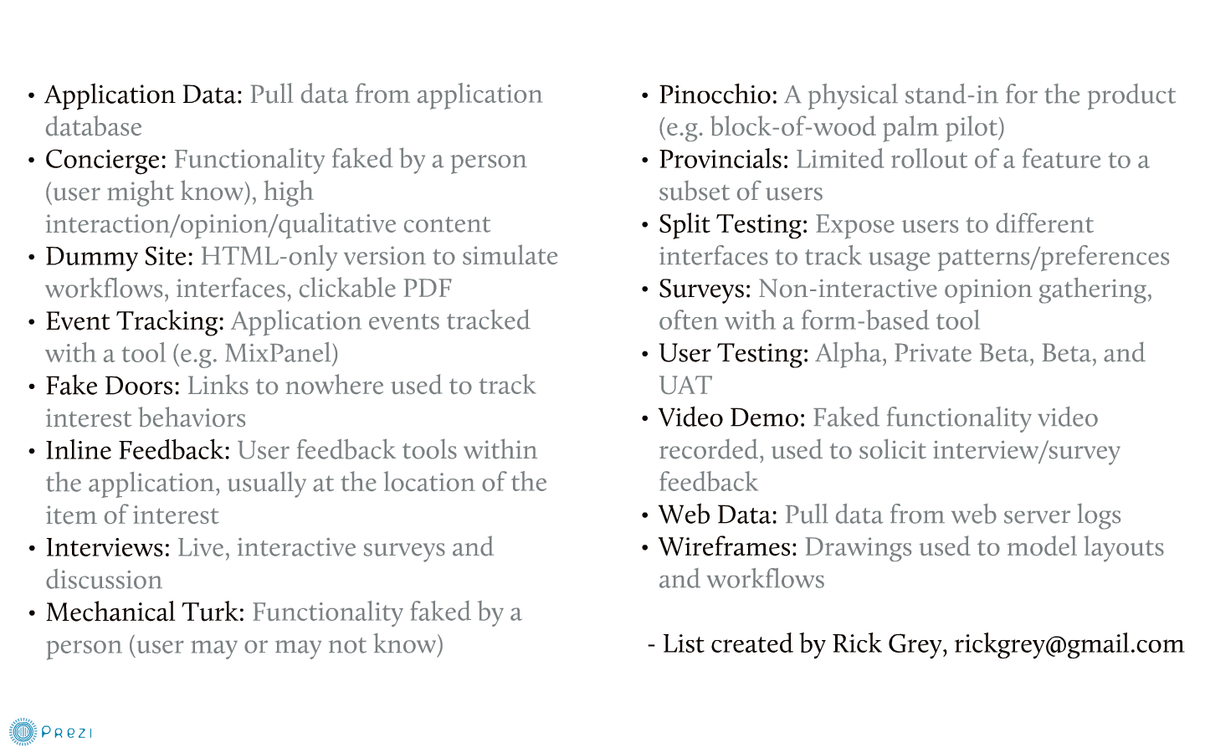
@esconfs
#esconfs
Notes:
Mechanics…
What is ET?
What’s someone doing?

Slide 13
@esconfs
#esconfs
Notes:
Mechanics…
What is ET?
What’s someone doing?

Slide 14
@esconfs
#esconfs
Notes:
Mechanics…
What is ET?
What’s someone doing?

Slide 15
@esconfs
#esconfs
Notes:
Mechanics…
What is ET?
What’s someone doing?

Slide 16
@esconfs
#esconfs
Notes:
Mechanics…
What is ET?
What’s someone doing?

Slide 17
@esconfs
#esconfs
Notes:
Mechanics…
What is ET?
What’s someone doing?

Slide 18
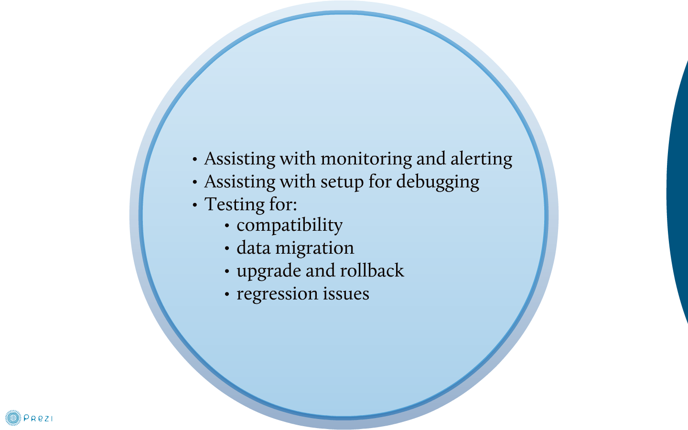
@esconfs
#esconfs
Notes:
Mechanics…
What is ET?
What’s someone doing?

Slide 19
@esconfs
#esconfs
Notes:
Mechanics…
What is ET?
What’s someone doing?

Slide 20
@esconfs
#esconfs
Notes:
Mechanics…
What is ET?
What’s someone doing?

Slide 21
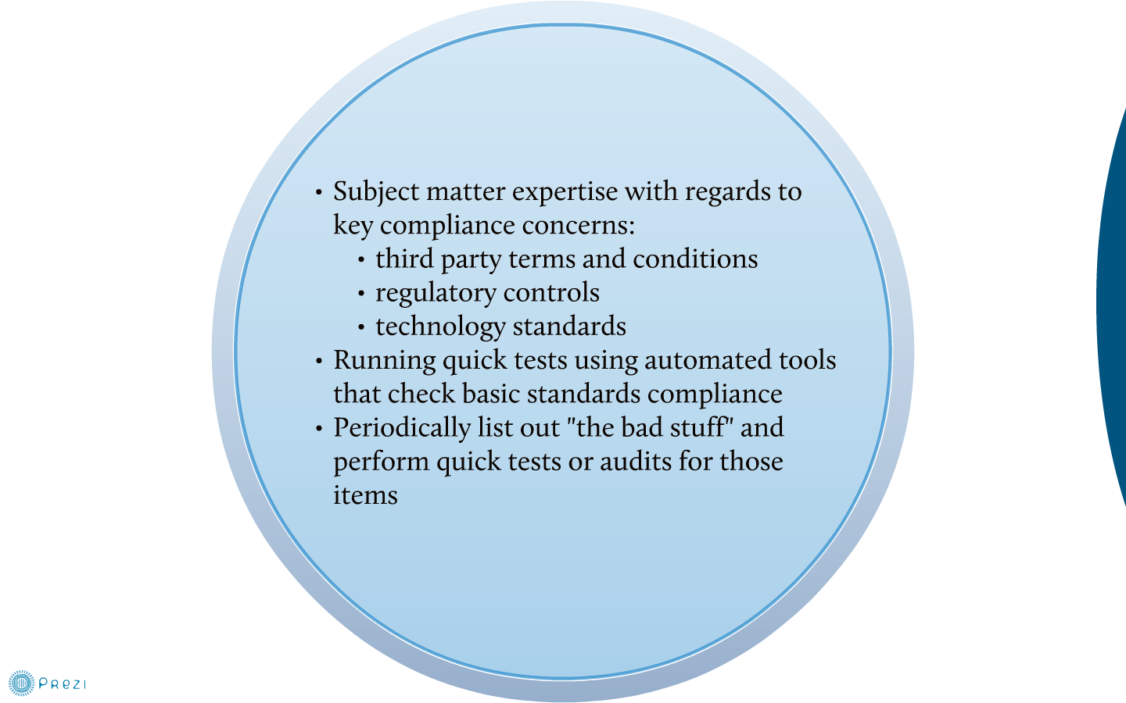
@esconfs
#esconfs
Notes:
Mechanics…
What is ET?
What’s someone doing?

Slide 22
@esconfs
#esconfs
Notes:
Mechanics…
What is ET?
What’s someone doing?

Slide 23
@esconfs
#esconfs
Notes:
Mechanics…
What is ET?
What’s someone doing?

Slide 24
@esconfs
#esconfs
Notes:
Mechanics…
What is ET?
What’s someone doing?

Slide 25
@esconfs
#esconfs
Notes:
Mechanics…
What is ET?
What’s someone doing?

Slide 26
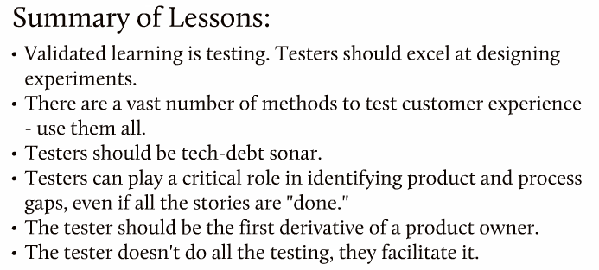
@esconfs
#esconfs
Notes:
Mechanics…
What is ET?
What’s someone doing?

Slide 27
@esconfs
#esconfs
Notes:
Mechanics…
What is ET?
What’s someone doing?

