Slide 1
Today’s webinar is presented by Michael Kelly. He will discuss Tips for Writing Better Charters for Exploratory Testing Sessions.
Welcome to the EuroSTAR Webinar Series
This webinar is due to start at 2pm. Make sure you stick around at the end for the Q&A session and continue the conversation with the speaker on Twitter after the show!
@esconfs
#esconfs

Slide 2
Tips for Writing Better Charters for Exploratory Testing Sessions
Michael Kelly, DeveloperTown
Mike Kelly is a managing partner at DeveloperTown, a venture development firm. Mike is a contributing author to “How to Reduce the Cost of Software Testing”, is a past director and president for the Association for Software Testing, and a co-founder of the Indianapolis Workshops on Software Testing, a series of ongoing meetings on topics in software testing.

Slide 3
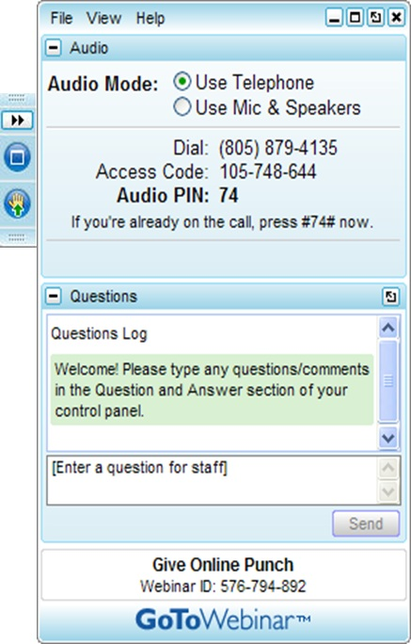
Q&A
If you have a question, the control panel on the right has a Questions box. All questions will be answered at the end of the presentation.
The GoToWebinar attendee interface is made up of two parts. The Viewer Window shows the presenter’s screen. The Control Panel is where attendees can interact and ask questions.
The webinar will be recorded and you will be notified via email when it is available.

Slide 4
How can I get the slides?
Slides and all materials will be posted on the EuroSTAR blog as well as emailed to you.

Slide 5
Join the conversation on Twitter
#esconfs
@esconfs
@michael_d_kelly
Continue the conversation with the speaker on Twitter after the show!

Slide 6
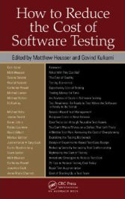
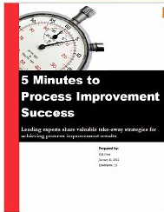
Michael Kelly
Managing Partner, DeveloperTown
www.DeveloperTown.com
Past President, Association for Software Testing
www.AssociationForSoftwareTesting.org
Articles and Blogs
www.MichaelDKelly.com
@esconfs
#esconfs

Slide 7
“The tester, the way they work, and their ability to work in the future, is as important as the product being tested.”
“One of the most difficult aspects of software testing is coming up with good test ideas. It doesn't matter how you're doing your testing: scripted vs. exploratory, manual vs. automated, or performance vs. functional.”
@esconfs
#esconfs

Slide 8
Exploratory Testing
“Simultaneous learning, test design, and test execution.” – James Bach
@esconfs
#esconfs

Slide 9
pure scripted
fragmentary test cases (scenarios)
freestyle exploratory
vague scripts
charters
roles
-image from Jon Bach
@esconfs
#esconfs

Slide 10
Session Based Test Management
A method for managing exploratory testing. Created by Jon and James Bach, refined by others.
@esconfs
#esconfs

Slide 11
charters
time-boxed
session notes
debriefs
team prioritization
ad-hoc test documentation
ad-hoc test automation
dynamic metrics and reporting
@esconfs
#esconfs

Slide 12
Chartering
Making your own decisions about what you will work on and how you will work. Understanding your client’s needs, the problems you must solve, and assuring that your work is on target.
@esconfs
#esconfs

Slide 13
Bad Chartering
What the tester thinks
What happens on the project
What am I suppose to be doing?
I need more time!
This is boring…
What data should I be using for this?
Didn’t someone already test this?
Is this really the most important thing for me to be focused on?
Areas of the product don’t get covered.
Entire categories of risk don’t get tested.
Duplication of effort.
The team does not work based on priority.
Testers get frustrated.
Poor visibility into actual progress.
@esconfs
#esconfs

Slide 14
Essential elements of a charter
Risk, Coverage, and Timeframe
@esconfs
#esconfs

Slide 15
Coverage
Why am I running this test? What could go wrong? What am I looking for?
Risk
What am I testing? Which features, screens, artifacts, or areas of the product should I be touching while testing?
How long should it take to perform this testing? Are there setup tasks I should do before I officially start? What do I need to do when I’m done?
Timeframe
@esconfs
#esconfs

Slide 16
When you look at a list of 10 charters,
you should see 10 distinct testing missions,
equating to around eight to 10 hours
of heads-down testing.
@esconfs
#esconfs

Slide 17
Better Chartering
List specific risks and coverage targets
Leverage mnemonics for risk and coverage ideas
Develop a knowledge base for risk/coverage summaries
Compare missions
Try developing a couple of templates
Charter for smaller sessions, then affinity map to create larger sessions
Thumb vote for priority
Use testing polarities
Let charters emerge over time
Track metrics
@esconfs
#esconfs

Slide 18
List Specific risk and coverage targets
Test the portal for reporting accuracy.
Which reports?
What do you mean by accuracy?
Test reports X, Y, and Z for errors related to start and end time selection criteria, summing, totaling, and rounding.
@esconfs
#esconfs

Slide 19
Mnemonics for Risk and Coverage ideas
Application Touring: FFC CUTS VIDS
Coverage: SFDPOT
Coverage and Risk: FIBLOTS
Quality Criteria: CRUSSPICSTMPL
Test Techniques: FDSFSCURA
Oracles: HICCUPPS
Session Notes: MCOASTER
@esconfs
#esconfs

Slide 20
Risk and Coverage Knowledge Base
As a team, build out a wiki detailing the nuance of various coverage areas and specific areas of risk.
Commonly captured items will include:
Detailed feature listings/checklists
Integration points and data flow
Example and common test data / test beds
Known issues/gotchas
Application-specific or feature-specific test techniques
@esconfs
#esconfs

Slide 21
Compare Missions
Test feature X
Stress test feature X
Performance test feature X
What’s the difference?
@esconfs
#esconfs

Slide 22
Charter
Template
Some examples:
• My mission is to test for various boundary errors for Microsoft Word’s bullets and numbering feature.
• My mission is to test for accurate error messaging pop-ups for Ford Motor Vehicle's Build and Price
website.
• My mission is to test for SQL injection vulnerabilities for application login and administration screens.
My mission is to test
<insert risk here> for
<insert coverage here>
@esconfs
#esconfs

Slide 23
Kiwanis International App (possible 10 to 15 min charters)
Charter for
Smaller Sessions
Test for boundary related issues related to projects
Test for boundary related issues related to project reports
Test for deliverability related issues related to project emails
Test for data quality issues with clubs available on the app
Test for data accuracy issues related to calculations on project reports
Test for data accuracy issues related to calculations on service and fundraising summary stats
Test for data accuracy issues related to Piggy Bank commitment calculations
Perform basic link validation for items in the news feed
Perform a copy review of the various descriptive dialogs in the app looking for typos and grammar issues
Test for performance related issues related to mapping capabilities
Stress test the application to identify conditions that crash the app
@esconfs
#esconfs

Slide 24
Thumb
Vote
Thumb Vote 101
High Priority
“We need to run this charter.”
Medium Priority
“If we have time, we should run this charter.”
Low Priority
“It’s a test, and we could run it, but likely there are better uses of our time.”
Walk your charters quickly as a team
Use thumb voting to see if there is agreement around clarity and scope
The particularly contentious charters will lead the team to discussion and debate (and new charters)
@esconfs
#esconfs

Slide 25
Testing Polarities
Example Polarities:
Warming up vs. cruising vs. cooling down
Doing vs. describing
Careful vs. quick
Data gathering vs. data analysis
Working with the product vs. reading about the product
Working with the product vs. working with the developer
Training (or learning) vs. performing
Product focus vs. project focus
Solo work vs. team effort
Your ideas vs. other peoples’ ideas
Lab conditions vs. field conditions
Current version vs. old versions
Feature vs. feature
Requirement vs. requirement
Coverage vs. oracles
Testing vs. touring
Individual tests vs. general lab procedures and infrastructure
Testing vs. resting
Playful vs. serious
The Process:
When you charter your tests, include polarities explicitly in your mission.
This practice is particularly effective for shorter test charters (20-30 minutes).
Or, when you charter, use the polarities to help you identify new charter ideas
In Your Charter:
Testing vs. Touring
Feature vs. Feature
Requirement vs. Requirement
While Chartering:
Individual Tests vs. General Lab Procedures
Coverage vs. Oracles
Lab Conditions vs. Field Conditions
Source: http://www.satisfice.com/blog/wp-content/uploads/2009/10/et-dynamics22.pdf
@esconfs
#esconfs

Slide 26
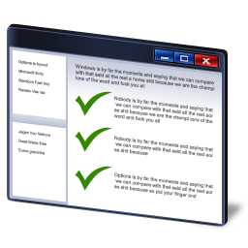
Let Charter Emerge over time
Pull down a charter for testing
Execute that charter
Debrief
After your debrief, add new charters and reprioritize existing charters
Repeat
@esconfs
#esconfs

Slide 27
Track
Metrics
Some examples:
Actual execution time vs. estimated time
Confidence factor of tester on their coverage of the stated risks
Number of follow up charters resulting from lack of time
Percentage of session time spent setting up for testing
Percentage of session time spent testing
Percentage of session time spent investigating problems
Time management is critical to chartering.
Metrics help provide visibility into what’s really happening. Tagging allows for easier metrics gathering.
I regularly tag the following:
bugs or issues for isolation (b)
possible new charters (c)
open questions (?)
tasks for automation (a)
tasks for documentation (doc)
setup, testing, investigation #...
@esconfs
#esconfs

Slide 28
Better Chartering
List specific risks and coverage targets
Leverage mnemonics for risk and coverage ideas
Develop a knowledge base for risk/coverage summaries
Compare missions
Try developing a couple of templates
Charter for smaller sessions, then affinity map to create larger sessions
Thumb vote for priority
Use testing polarities
Let charters emerge over time
Track metrics
@esconfs
#esconfs

Slide 29
Questions?

Slide 30
EuroSTAR Webinar Archive
Access almost 50 on-demand software testing webinars by the world's leading testing experts. Topics include….
Agile, Automation, Test Management, Process Improvements, Risk-based Testing, Performance Testing, Test Documentation, Cloud Testing, Session-based Testing, Weekend Testers
Visit the archive!
http://www.eurostarconferences.com/community/member/webinar-archive
@esconfs
#esconfs

Slide 31
The EuroSTAR Community. Are you a member?
Did you know we have an online resource area with almost …
600 software testing presentations, 50 topical webinars, over 40 videos and podcasts and 20 expert eBooks
Do you know that membership is completely free and you can access these premium testing resources anytime?
Join today!
http://www.eurostarconferences.com/community/member
@esconfs
#esconfs

Slide 32
Are you coming to Amsterdam?
Join us in the RAI, Amsterdam from the 05-08 November for the 20th annual EuroSTAR Conference and help us celebrate our 20th anniversary!
Visit www.eurostarconferences.com to find out what you can expect to see at Europe’s largest software testing event!
@esconfs
#esconfs

